Slide 1
Segmentation and Detection
Computer Vision

Slide 2
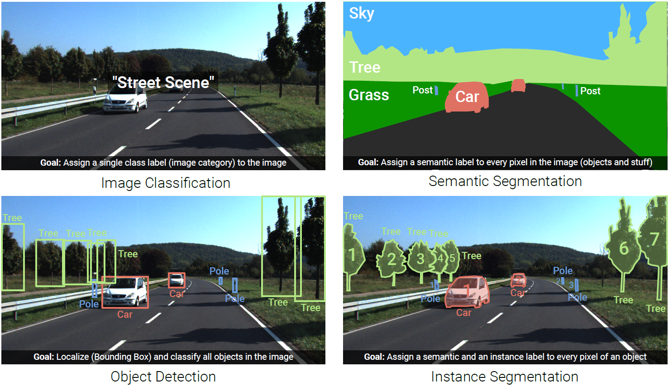
Image Understanding (Recognition)
combination of both: panoptic segmentation

Slide 3
A Few More Image Data Sets

Slide 4
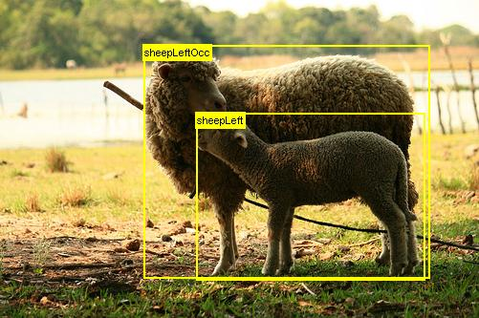
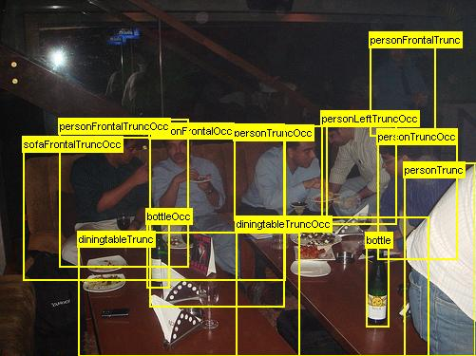
Pascal VOC Data Set
Pascal Visual Object Class challenge
widely used as benchmark for object detection and semantic segmentation
20 object categories such as person, sofa, sheep, car, …
11530 annotated images
available annotations: pixel-level segmentation, bounding boxes, object classes

Slide 5
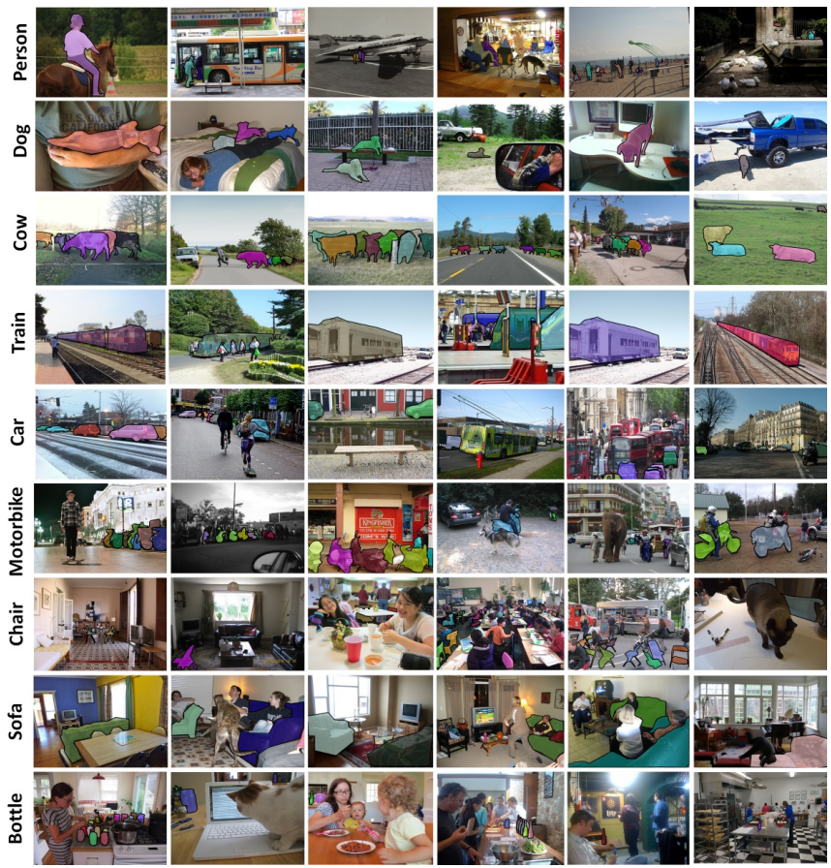
MS COCO Data Set
Microsoft Common Objects in Context
images of complex everyday scenes containing common objects in their natural context
91 objects types
2.5 million annotated instances in 328k images → instance segmentation

Slide 6
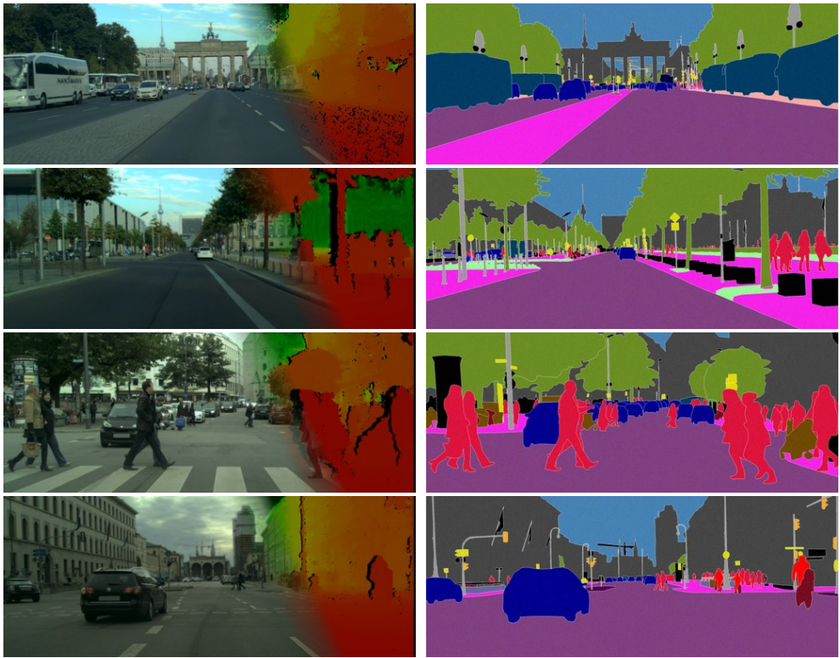
Cityscapes Data Set
(depth map)
annotation
goal: semantic understanding of urban street scenes (captured in 50 cities)
pixel annotations for 30 classes (person, car, building, …)
5000 fine-annotated and 20000 coarse-annotated images
source

Slide 7
Semantic Segmentation

Slide 8
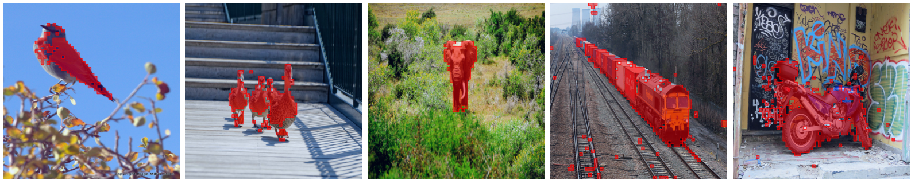
Object Segmentation from DINO
thresholding self-attention map of last layer:
not a full segmentation mask though …
source

Slide 9
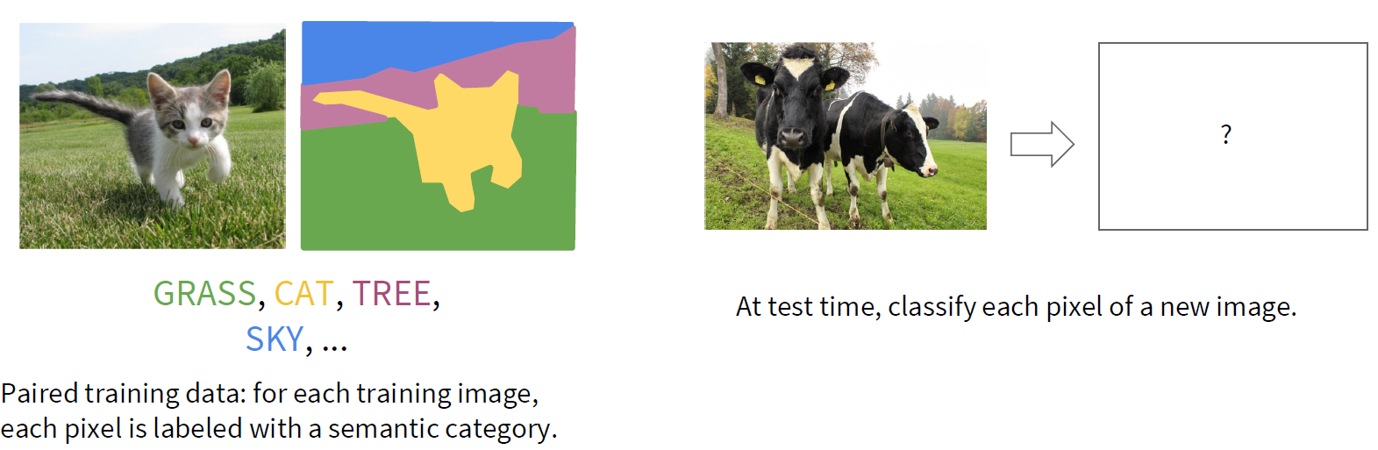
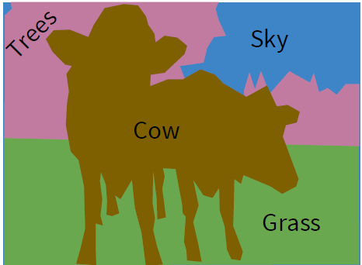
Classification of Each Pixel
segmentation: no objects, just pixels
minimize sum over classification losses (cross-entropy loss at every output pixel)

Slide 10
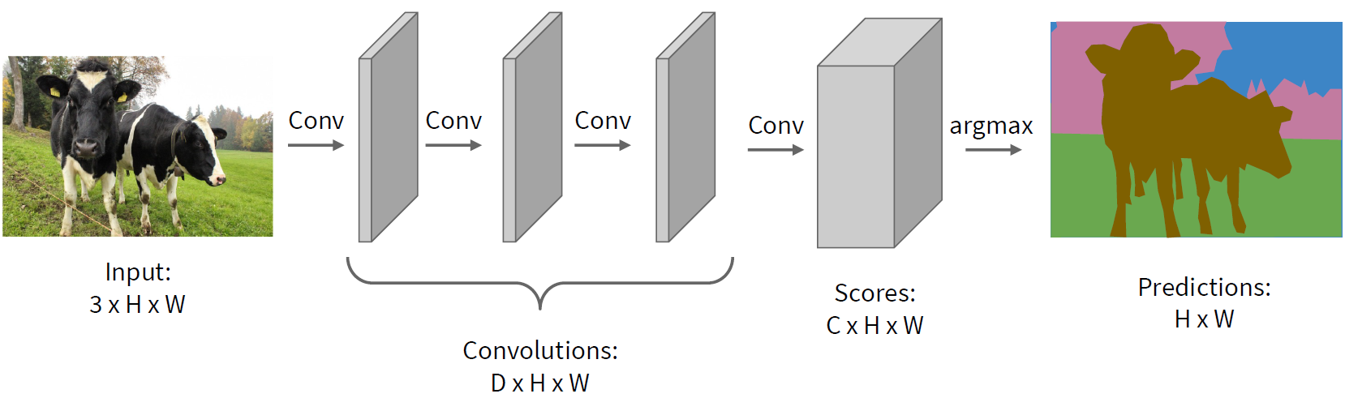
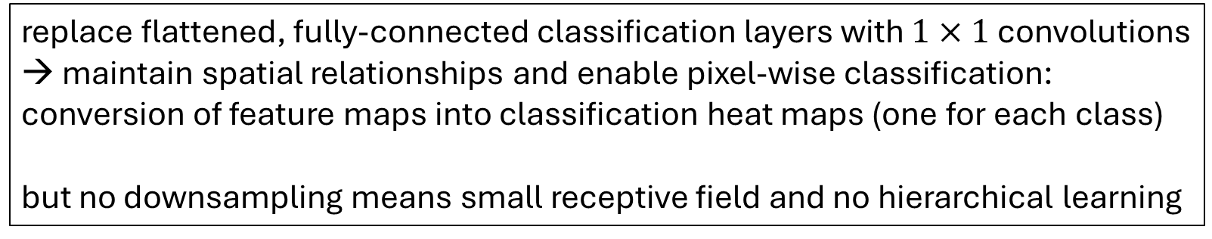
Idea: Fully Convolutional, No Downsampling
stride 1,
padding
→ small kernels
feature maps
categories
replace flattened, fully-connected classification layers with $1×1$ convolutions
→ maintain spatial relationships and enable pixel-wise classification: conversion of feature maps into classification heat maps (one for each class)
but no downsampling means small receptive field and no hierarchical learning

Slide 11
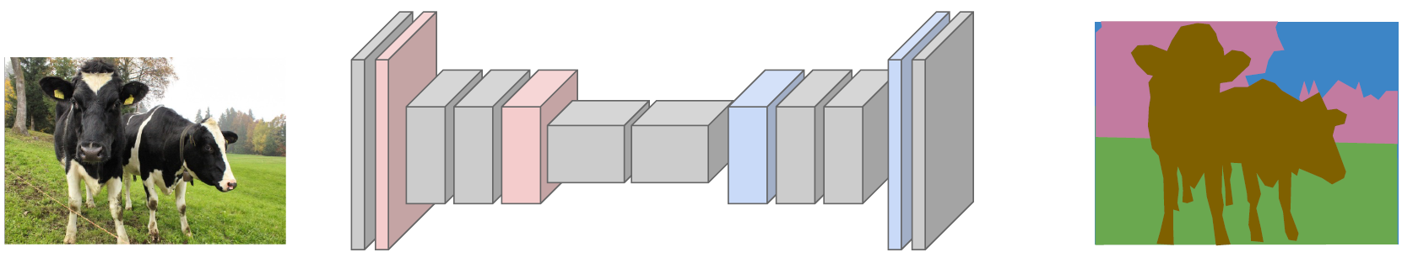
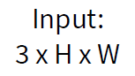
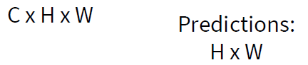
Upsampling to the Rescue
Fully Convolutional Networks
typical spatial feature extraction: convolution and pooling layers → downsampling
upsampling layers to restore original image size
pixel-wise classification
different options for down- (pooling, strided convolution) and upsampling ...

Slide 12
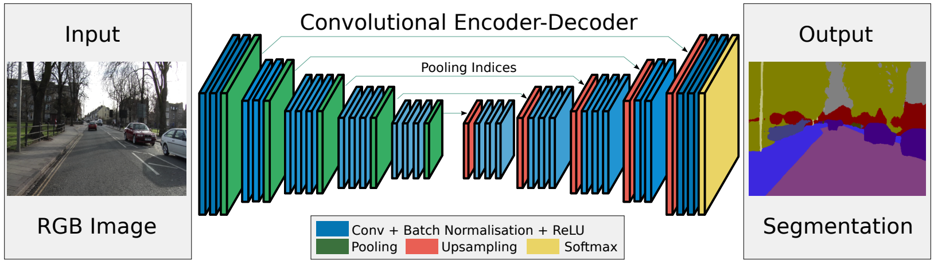
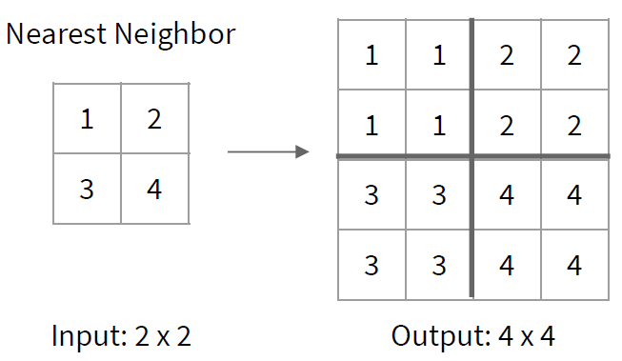
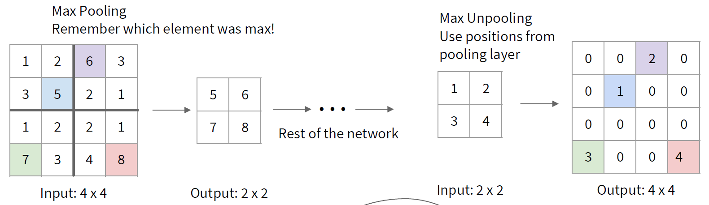
Reverse Pooling
unpooling (recording max positions from pooling)
resampling (no learned parameters)
source
filled with learned parameters in subsequent convolution

Slide 13
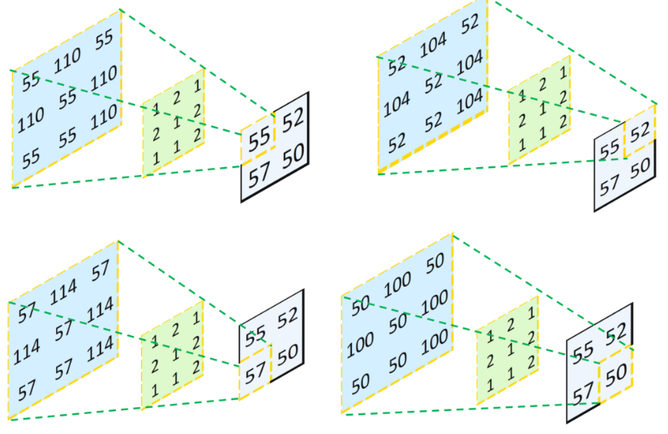
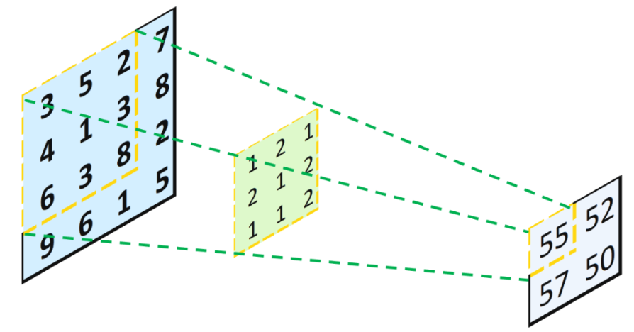
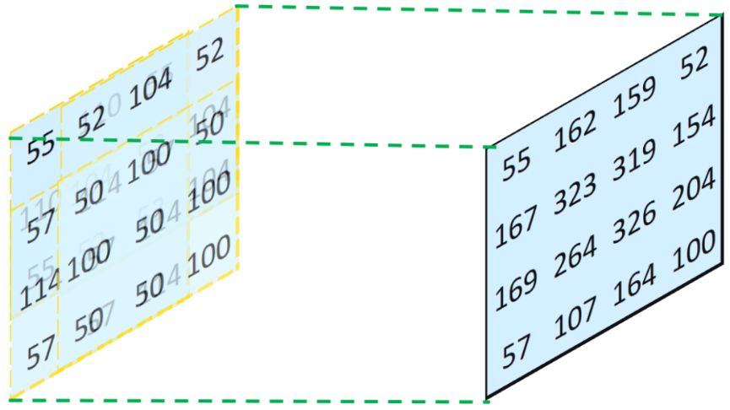
Reverse Convolution
transposed convolution
convolution
combine and sum overlaps:
not inverse convolution
→ additional learned parameters
source

Slide 14
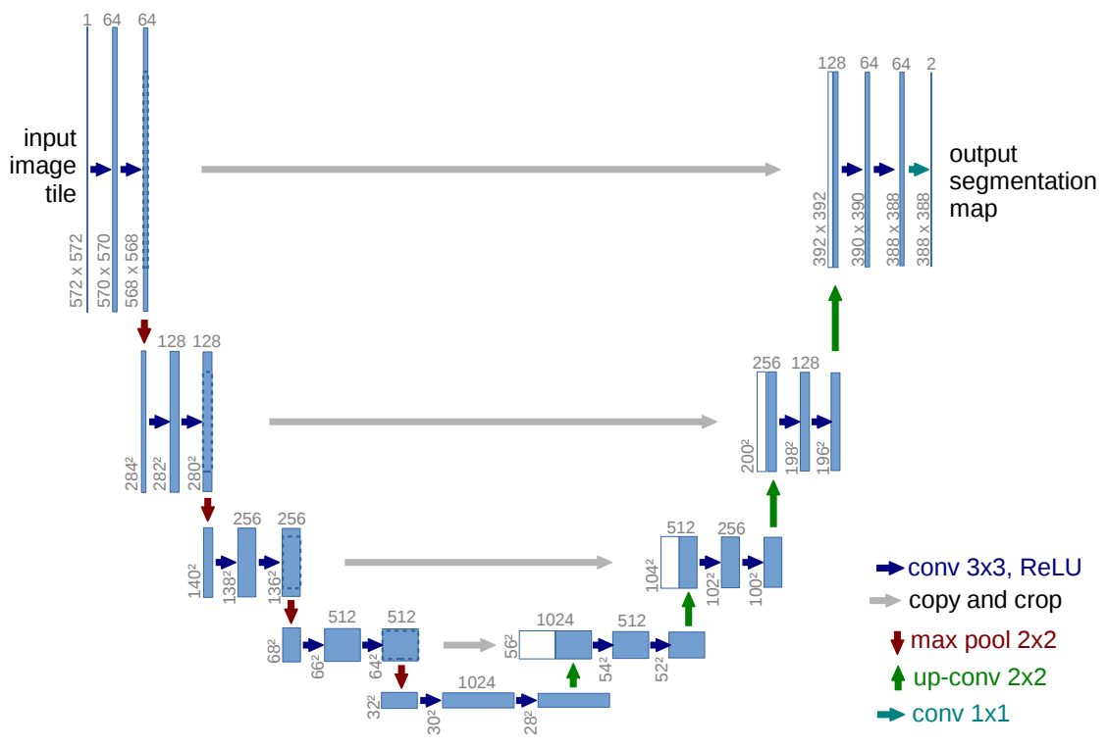
U-Net
number of channels / feature maps
just two classes
skip connections
also used for learning of depth maps, image synthesis (diffusion), ...

Slide 15
Aside: Autoencoders

Slide 16
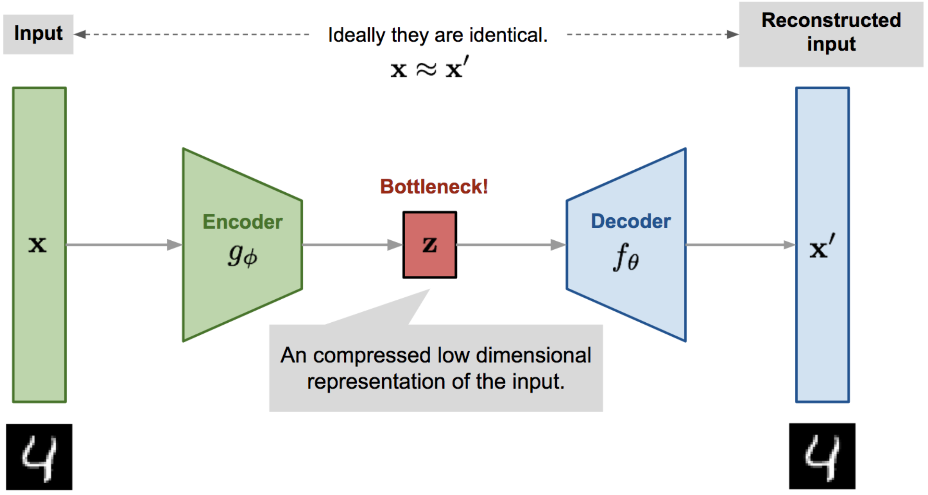
Autoencoder
for images:
convolutions
transposed convolutions
(deep) encoder network
(deep) decoder network
learned together by minimizing differences between original input and reconstructed input (expressed as losses)
compressed intermediate representation: dimensionality reduction
(alternative to PCA)
unsupervised learning
source

Slide 17
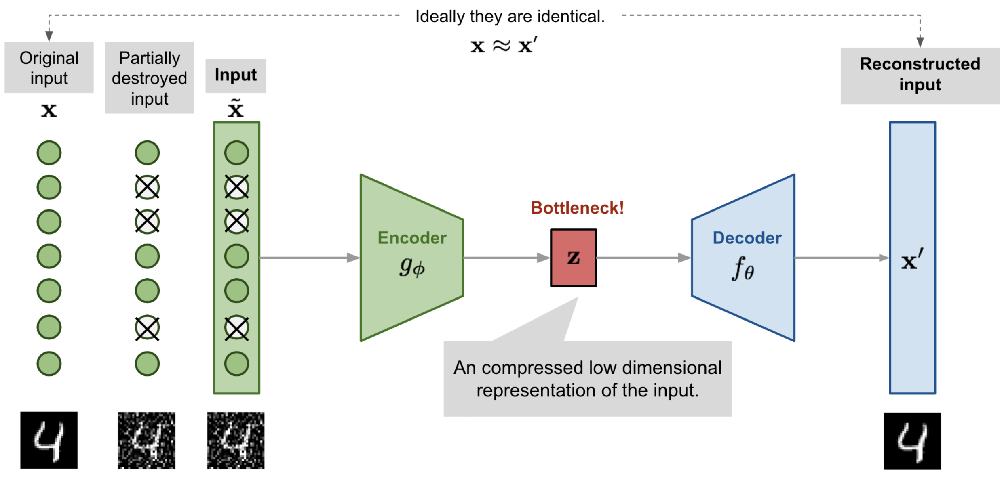
Denoising Autoencoder
goal: avoid overfitting and improve robustness of plain autoencoder
learn to remove noise of distorted input $\tilde{x}$ → restore original input $x$
similar to dropout
source
alternative to deconvolution (image restoration)

Slide 18
Object Detection

Slide 19
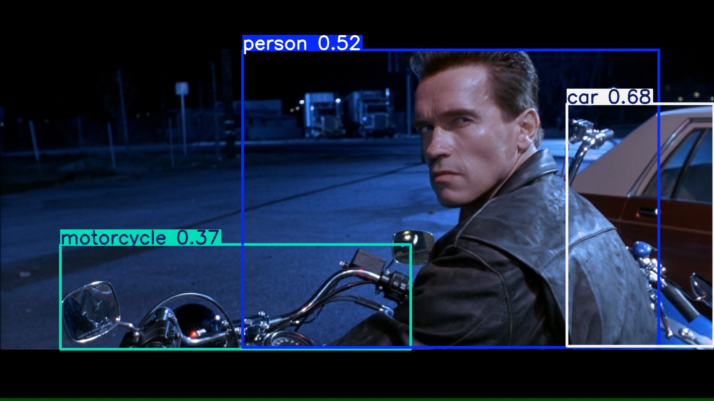
output: bounding boxes with category label and confidence

Slide 20
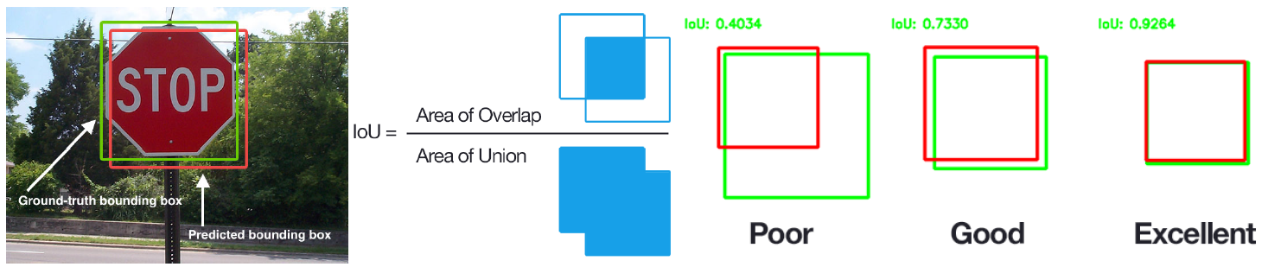
Performance Evaluation of Localization
Intersection-over-Union
images with multiple objects: number of detections dependent on used confidence threshold

Slide 21
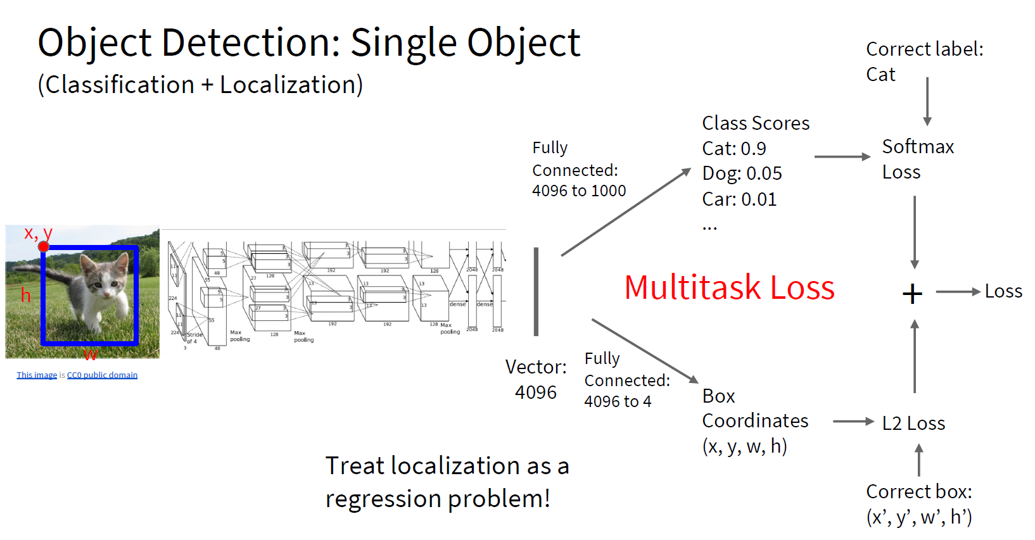
too complicated for multiple objects

Slide 22
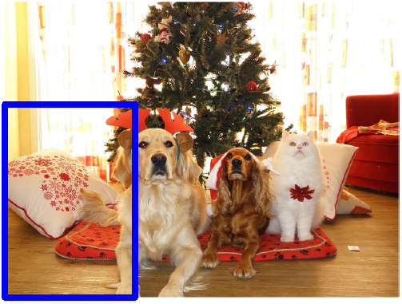
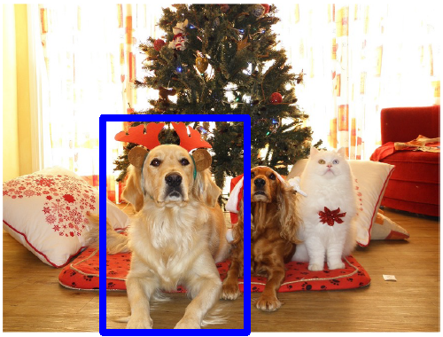
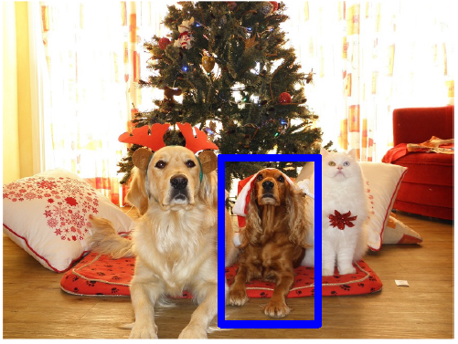
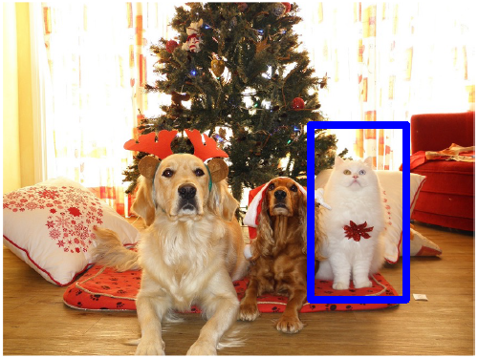
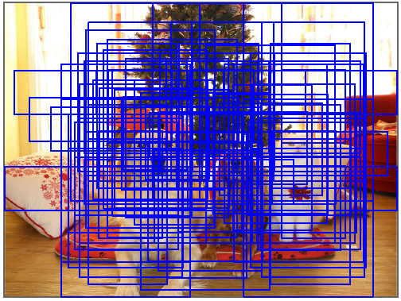
Localization for Multiple-Object Images
idea: classify many different crops of the image as object or background
(crops: sliding window over image, iterated at multiple window sizes)
Dog? No
Cat? No
Background? Yes
Dog? Yes
Cat? No
Background? No
Dog? Yes
Cat? No
Background? No
Dog? No
Cat? Yes
Background? No
issue: too many possible crops
→ need for region proposals

Slide 23
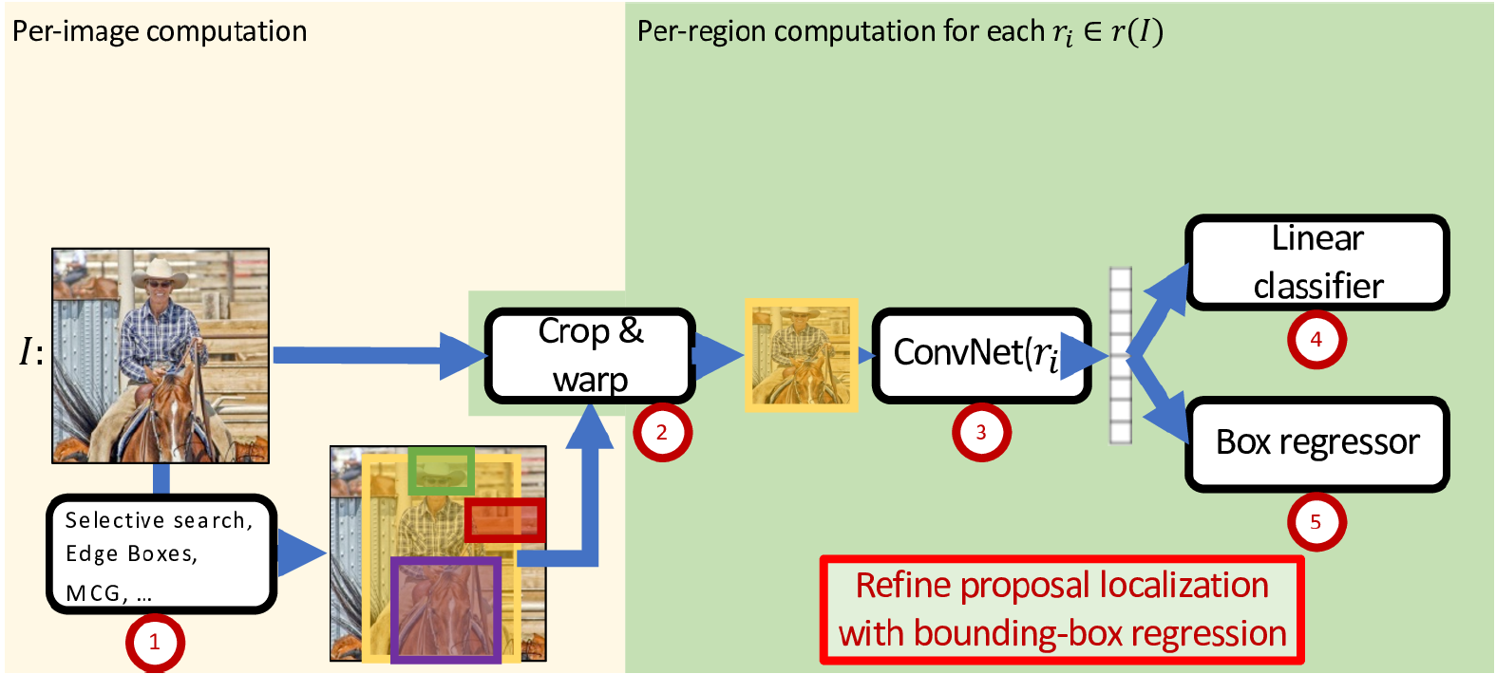

Region-Based Convolutional Neural Network (R-CNN)
task-specific heads:
two stages
object classification
feature representation
(forward-pass through pretrained CNN)
bounding-box refinement
region proposals by “classic” method (~2k)

Slide 24
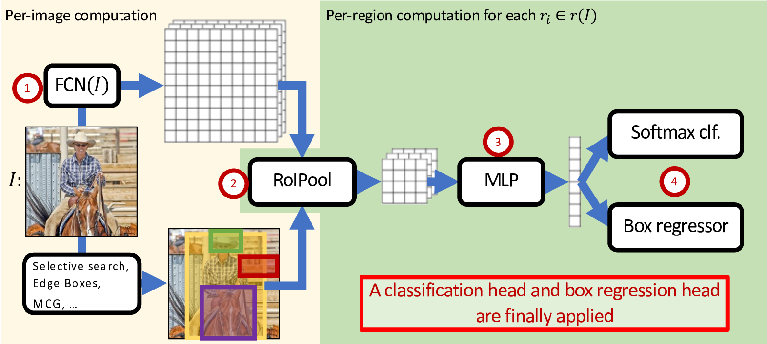
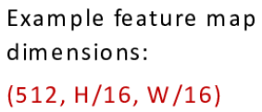
Fast R-CNN: Crop ConvNet Features
Fully Convolutional Network
(pretrained)
feature sharing
end-to-end trainable
fixed-dimensional representation
Region of Interest pooling
or CNN
more lightweight

Slide 25
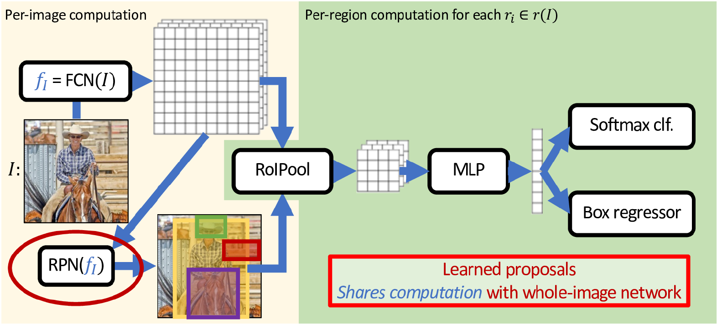
Faster R-CNN: Use Region Proposal Network
binary classification (object or not) with sliding window

Slide 26
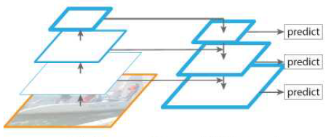
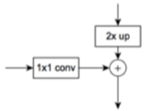
Feature Pyramid Network (FPN)

Slide 27
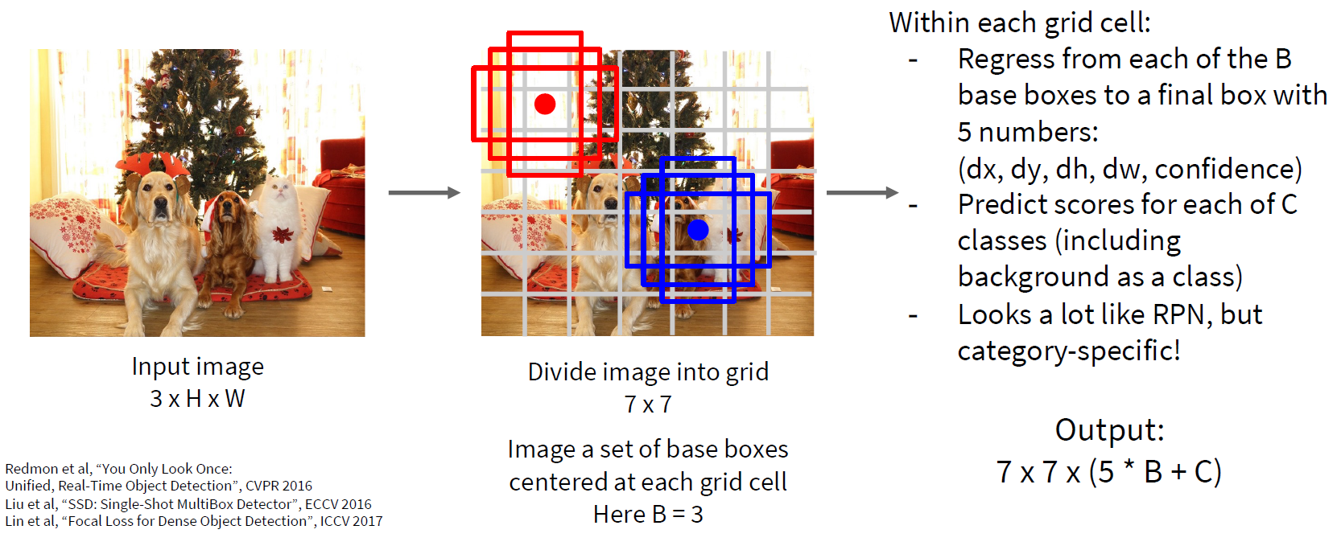
Single-Stage Detectors: Drop Per-Region Computation
faster, but usually worse performance

Slide 28
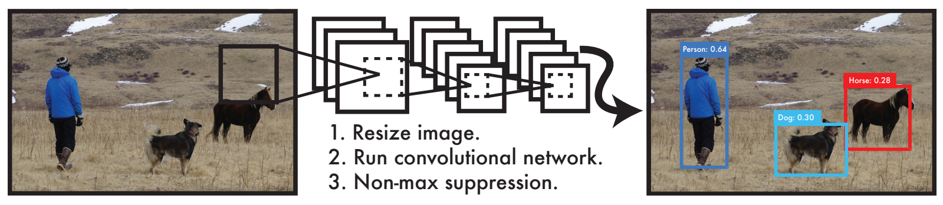
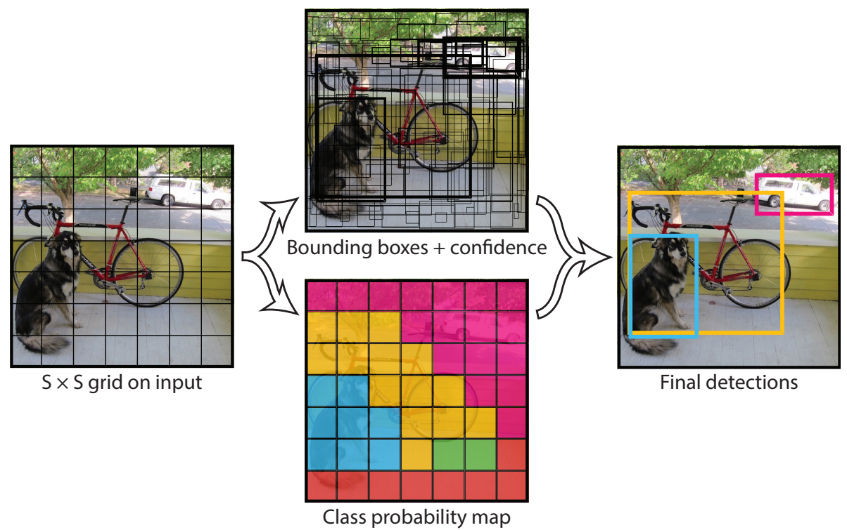
YOLO: Real-Time Object Detection
You Only Look Once:
prediction of bounding boxes and class probabilities in one go

Slide 29
Object Tracking
task: locating an object in successive video frames
basic approach:
detection: localize target object(s) (e.g., YOLO)
motion estimation: predict next location (e.g., Kalman filter or optical flow)
appearance matching: comparison of previous and predicted next location (e.g., feature descriptor, CNN features)
detection repeated frequently to correct for accumulated deviations

Slide 30
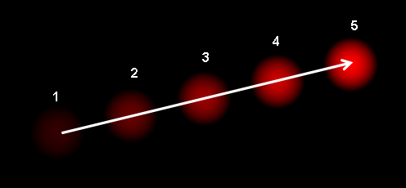
Optical Flow
dense optical flow:
estimate motion vector of every pixel
e.g., Horn-Schunck method or Lucas-Kanade (LK) method
sparse optical flow:
estimate motion vector of few image features
e.g., Kanade-Lucas-Tomasi (KLT) feature tracker

Slide 31
Instance Segmentation

Slide 32
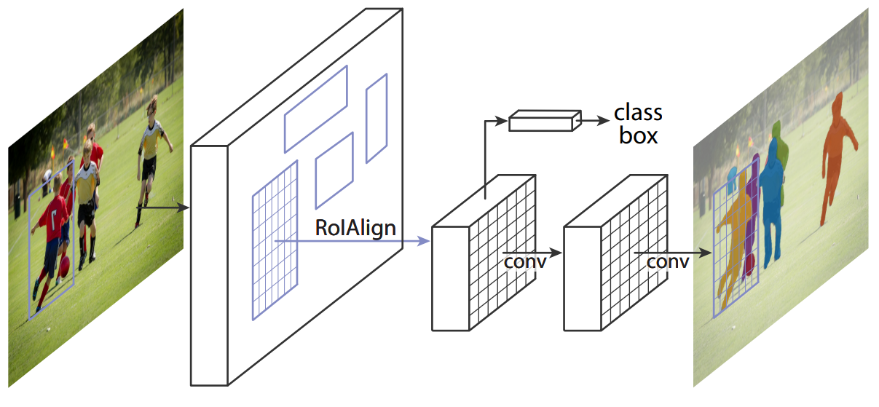
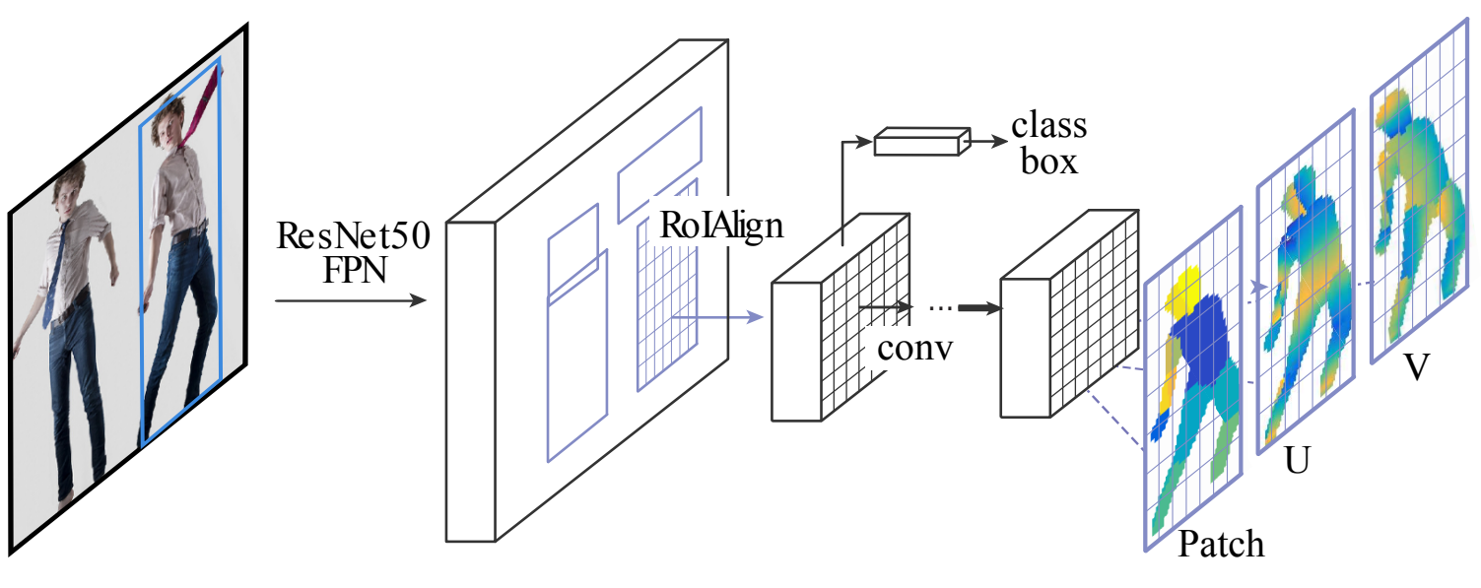
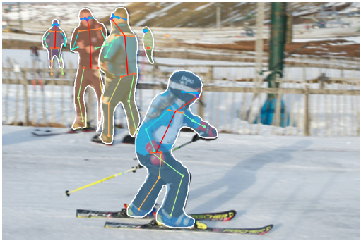
Add Additional Network Heads to R-CNN
instance segmentation (Mask R-CNN):
pose estimation (DensePose):
3D model’s surface to 2D

Slide 33
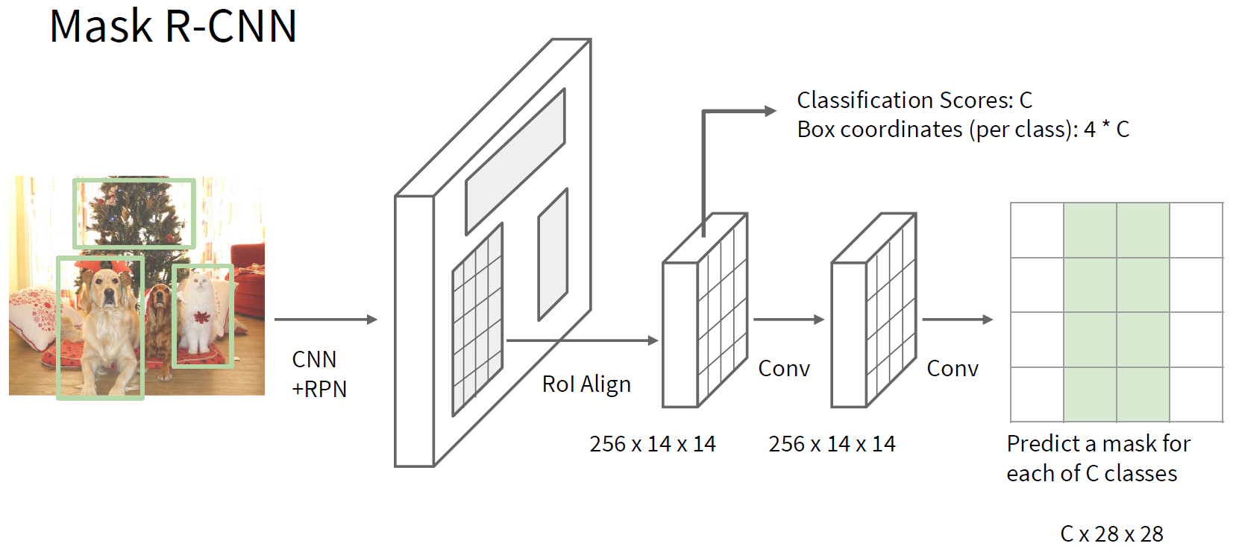
Faster R-CNN

Slide 34
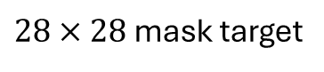
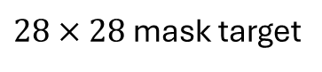
image with training proposal
$28×28$ mask target
image with training proposal
$28×28$ mask target

Slide 35
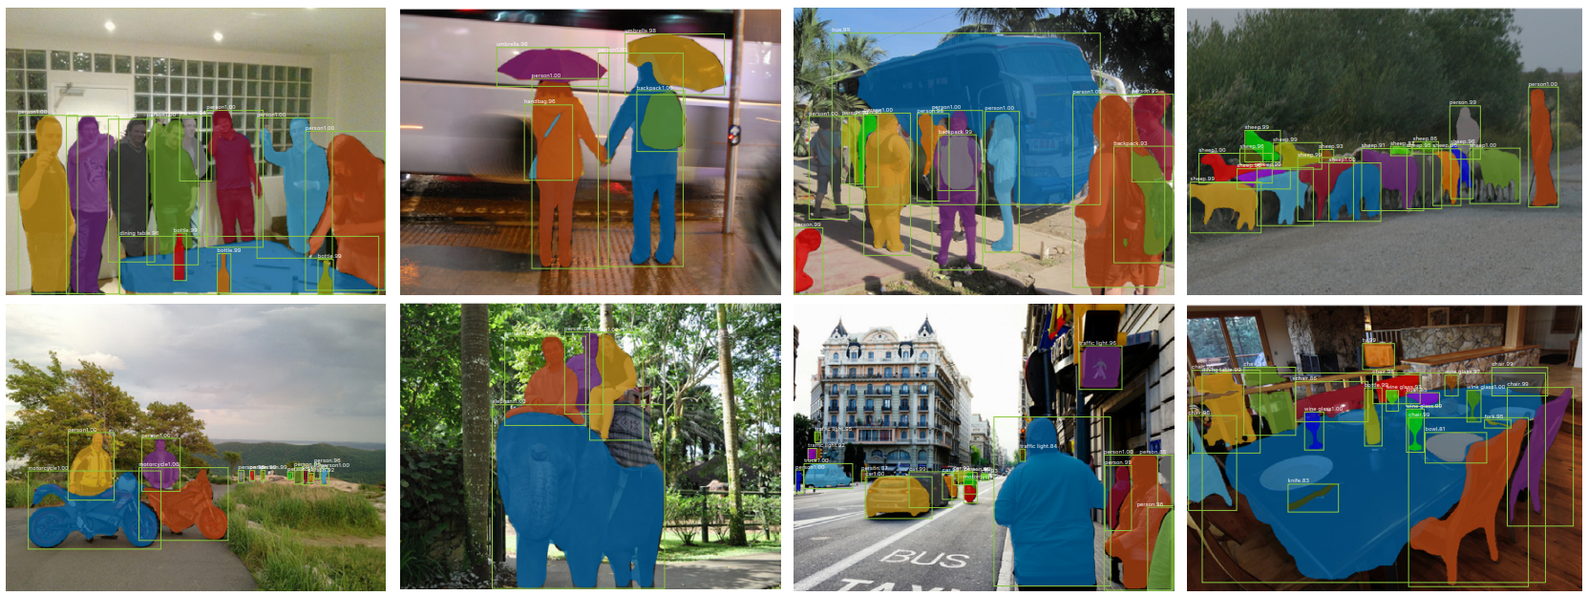
results on MS COCO data set

Slide 36
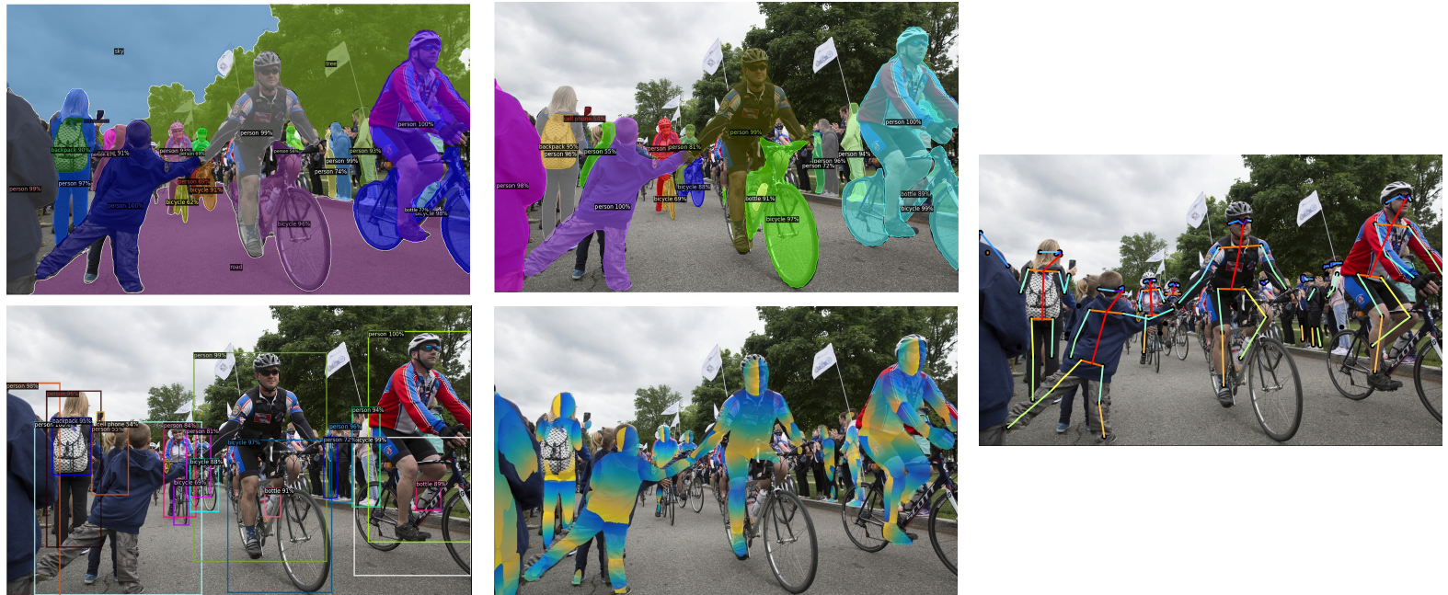
Detectron2: PyTorch Implementations

Slide 37
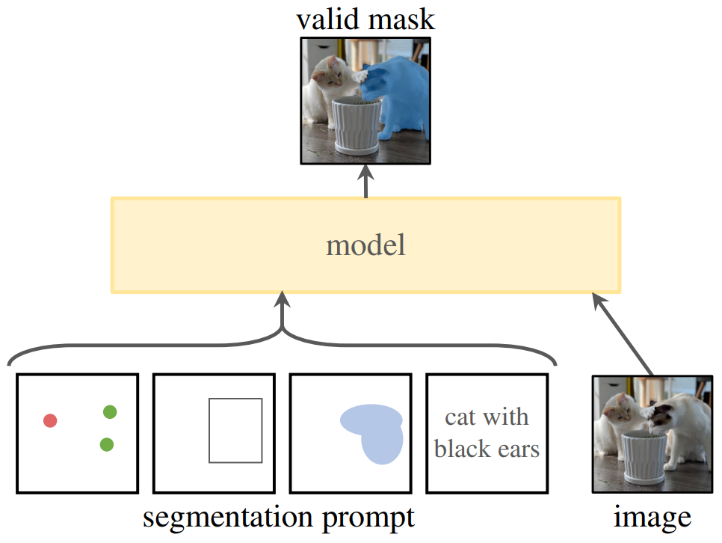
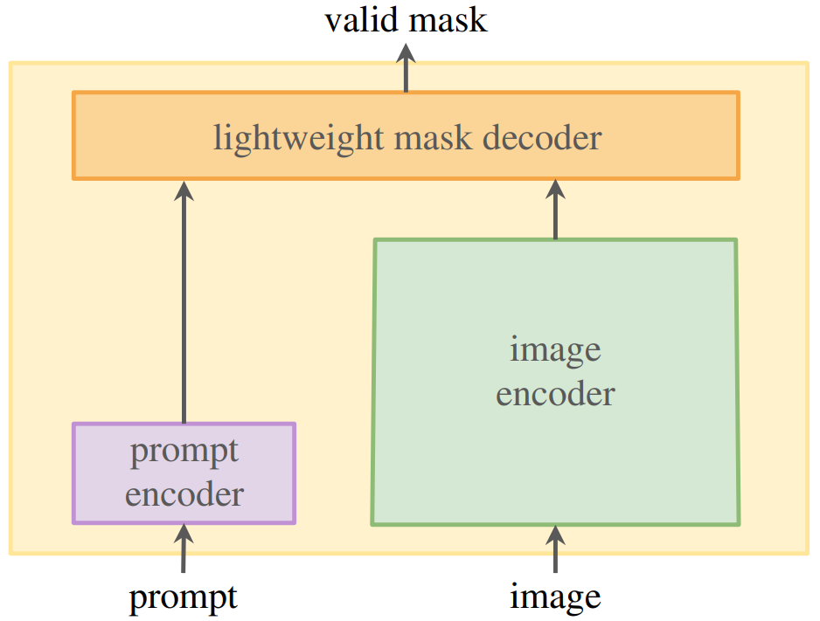
Promptable Segmentation with Transformers
Segment Anything Model (SAM)
SAM2 includes also video segmentation
transformer decoder
ViT
CLIP

